Slide 1
Food Insecurity and Obesity
By Sophia Harris, Sam McFarland, Esal Shakil, Nika Yermakova

Slide 2
Overview
01
04
02
05
03
Introduction
Moderation
Descriptives/
Correlation
Conclusion
Cluster Analysis

Slide 3
01
Introduction
Research question, inspirations, and data sets utilized.

Slide 4
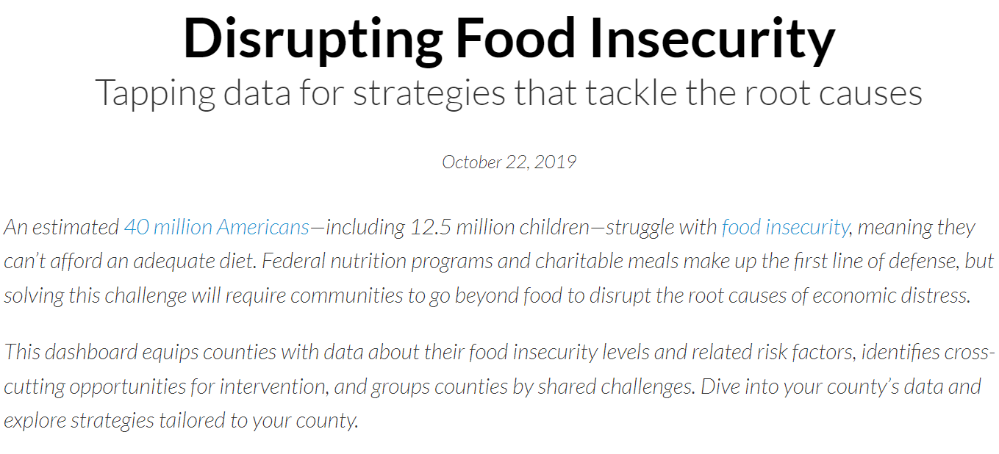
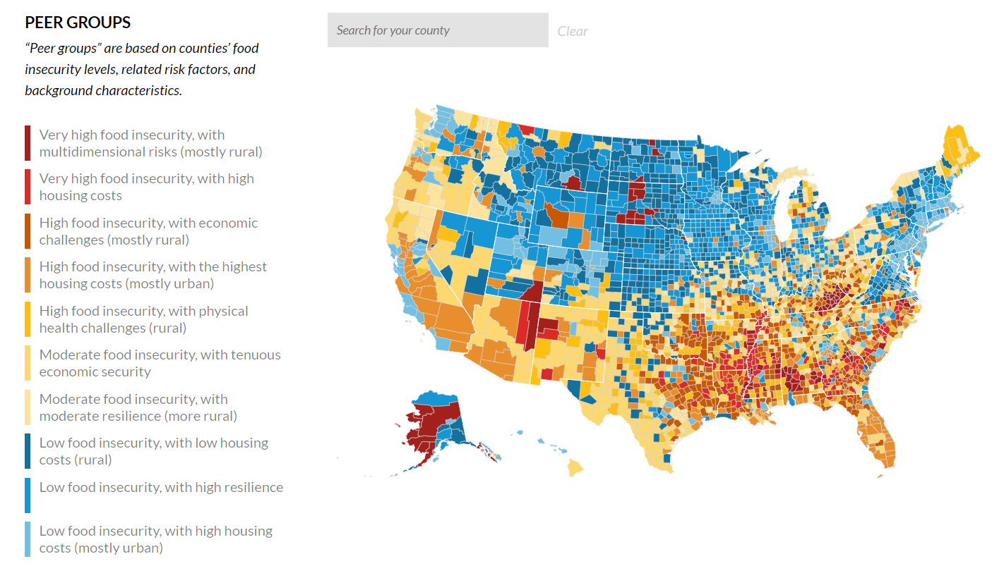
The Urban Institute Report
This all started with a report published by the Urban Institute where they conducted a cluster analysis that looked at food insecurity and other related factors across counties. They were doing this in order to determine strategies that tackle the root causes of food insecurity.

Slide 5
We wanted to do something similar
Their report inspired us to also look at food insecurity, but with the inclusion of another variable - obesity.
We were curious, can food insecurity coexist with obesity? Is there are relationship between these two seemingly contradicting variables?
Spoiler: past research (and our own analysis) indicated yes!
But extending upon that, what underlying factors contribute to this relationship?
We wanted to expand upon the urban institute report, by not only adding another variable to the cluster analysis, but also understanding more deeply the complexities of this relationship.
Food Insecurity → Obesity?

Slide 6
Food Insecurity
What is food insecurity?
The Urban Institute defined individuals that have food insecurity as: lacking access to enough food for an active, healthy life or limited or uncertain availability of nutritionally adequate foods for all household member.
In 2022, the USDA reported that 12.8% (17.0 million) of U.S. households experienced food insecurity at some point during the year.
This issue extends beyond mere hunger, affecting the quality and adequacy of the diet, leading to low food expenditures, low fruit and vegetable consumption, and lower-quality diets, which can significantly affect health outcomes.

Slide 7
Food Insecurity
What data did we use?
Since we had taken inspiration from the urban institute report, we utilized the data that they had posted on their GitHub.
Their data was a contribution of data sets from multiple sources that spanned from around 2010-2017.
Besides food insecurity, they had 18 other variables, which we utilize for analyses.
Most of these variables were recorded as proportions with the exception of median income and credit scores.
They focused on individuals and households in the US experience food insecurity, with consideration of other factors such as income, employment, health, housing costs, and demographic characteristics.

Slide 8
Obesity
What is obesity?
The World Health Organization defined obesity as a chronic complex disease characterized by excessive fat deposits that can impair health.
Nationally, 41.9% of adults have obesity, according to the TFAH (2023).
This statistic is alarming because obesity is not merely a cosmetic concern, but it is associated with serious health implications. Individuals with obesity face an increased risk of 2 diabetes, cardiovascular diseases, hypertension, and certain cancers.

Slide 9
Obesity
What data did we use?
The data was sourced from the Behavioral Risk Factor Surveillance System (BRFSS)
They had data spanning across a multitude of years, but we decided to only utilize the data from the year 2016, since that aligned with the food insecurity data the most.
The BRFSS employed Random Digit Dialing (RDD) to randomly select participants. Trained interviewers conducted the surveys over the phone, asking respondents to self-report their height and weight, which were then used to calculate BMI.
The data set had the proportion of obesity for each county.

Slide 10

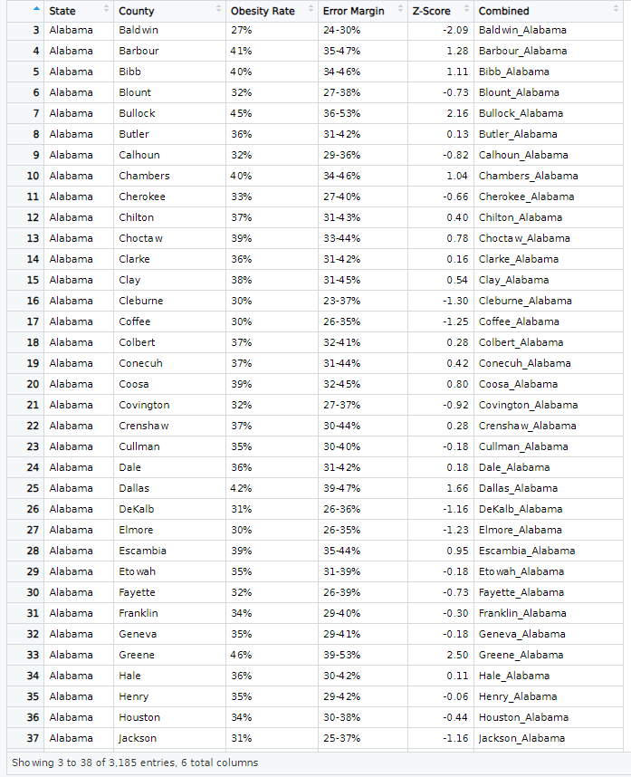
Obesity
The only issue was that each state was in a separate file, so we had to combine all 50 states into one dataframe.
→

Slide 11
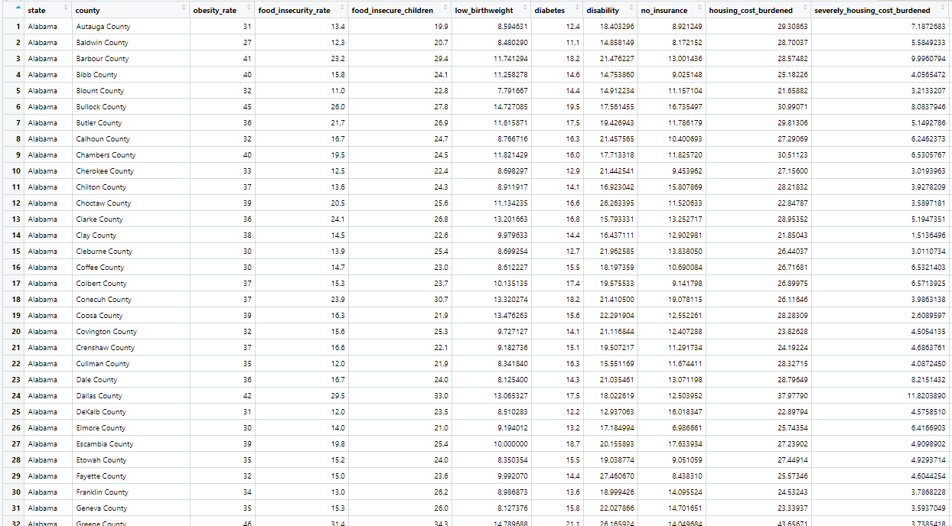
Data Combination
We combined the food insecurity data with the obesity data and ended up with 20 variables.
Here is a snippet of our data + all of the variables.
Obesity rates
Food insecurity rates
Food insecure children
Low birthweight
Diabetes
Disability
No insurance
Housing cost burden
Severely housing cost burden
Wage fair market rent
Median income
Below poverty
Unemployment
Credit score
Debt
Children
Seniors
People of color
Less than college education
Rural population

Slide 12
02
Descriptives/Correlation
Now, that we have our data, we can start working with it. Let’s look into some basic stats.

Slide 13
More information on our variables
Here are some descriptive stats for the variables we are most interested in.
As a reminder, these are for the years 2010-2017.
Variable | Mean | Median | Min | Max | Standard Dev
Food Insecurity | 13.68% | 13.10% | 3.70% | 36.10% | 3.56%
Obesity | 30.98% | 31.00% | 11.00% | 47.00% | 4.45%
People of Color | 22.92% | 15.51% | 0.00% | 99.24% | 20.00%
Less than College Edu. | 70.39% | 71.86% | 16.80% | 93.11% | 10.08%
Median Income | $48,549.16 | $46,667.00 | $18,972.00 | $134,464.00 | $13,228.51
Rural Population | 58.54% | 59.44% | 0.00% | 100.00% | 31.47%

Slide 14
What is a correlation analysis?
For our project, we will specifically utilized the pearson's product-moment correlation.
This type of correlation is defined as a statistical measure that evaluates the strength and direction of the linear relationship between two continuous variables. It is denoted by the symbol r and ranges from -1 to 1.
For reference, here is how to interpret the coefficient:
r=1: Perfect positive linear correlation (as one variable increases, the other variable increases proportionally).
r=−1: Perfect negative linear correlation (as one variable increases, the other variable decreases proportionally).
r=0: No linear correlation (the variables do not have any linear relationship).
In other words, the closer r is to 0, the stronger the relationship.

Slide 15
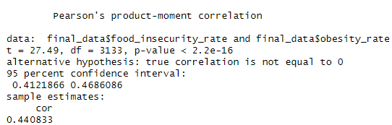
Pearson’s Correlation Results
When running a pearson’s correlation through r to see if there is a relationship between food insecurity and obesity, we got the following results:
Correlation Coefficient (r = 0.44): There is a moderate positive linear relationship between food insecurity rates and obesity rates. As food insecurity rates increase, obesity rates tend to increase as well.
Statistical Significance: The t-value of 27.49 + the very small p-value (< 2.2e-16) indicate that the correlation is statistically significant.
Conclusion: Since the correlation is positive and statistically significant, it suggests that higher food insecurity rates are associated with higher obesity rates.

Slide 16
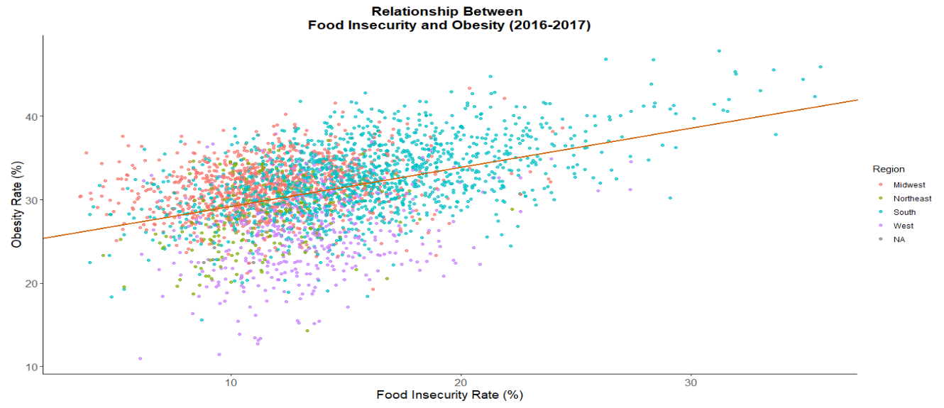
Notes:
Mention how this visualization reflects the correlation results where there seems to be a MODERATE positive relationship

Slide 17
Possible Explanation
Based on research, here are some possible explanations to this correlation
Food environment and economic factors: Industrial food processing floods the market with cheap, processed, energy-dense, nutrient-poor foods, disproportionately affecting low-income individuals. Economic hardships force reliance on inexpensive, calorie-dense options, contributing to obesity (Frongillo & Bernal, 2014; Drewnowski & Specter, 2004; Cristofar & Basiotis, 1992; Burns, 2004).
Taste preferences and stress: Preferences for sugar and fat influence food choices, reinforced by repeated exposure. Food insecurity induces chronic stress, leading to maladaptive coping strategies like overeating or binge eating (Drewnowski & Specter, 2004; Frongillo & Bernal, 2014).
Association with reward: Food scarcity may strengthen associations between food and reward, increasing food cravings and consumption, perpetuating unhealthy eating behaviors and weight gain (Frongillo & Bernal, 2014).

Slide 18
03
Cluster Analysis
Now that we know there is a statistically significant relationship between the two, it is time to run our own cluster analysis!

Slide 19
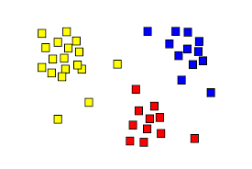
What is a Cluster Analysis
For our analysis, we will utilized a K-means clustering method.
As a reminder, the Urban Institute also conducted a cluster analysis, but they used hierarchical clustering, which is a different method.
K-means clustering refers to unsupervised machine learning algorithm used for partitioning a dataset into a pre-defined number of clusters. The goal is to group similar data points together and discover underlying patterns or structures within the data.

Slide 20
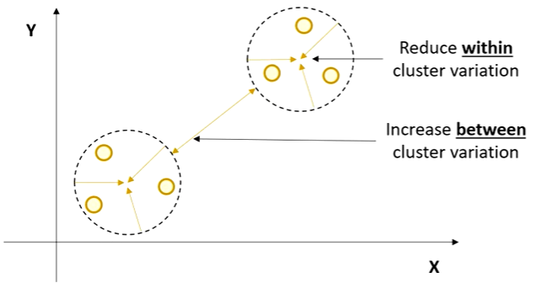
Cluster Analysis Objectives
Grouping similar data points: K-means aims to identify patterns in data by grouping data points that share similar characteristics together.
Minimizing within-cluster distance: The algorithm strives to make sure data points within a cluster are as close as possible to each other. This ensures tight-knit clusters with high cohesiveness.
Maximizing between-cluster distance: Conversely, k-means also tries to maximize the separation between clusters. Ideally, data points from different clusters should be far apart, making the clusters distinct from each other.

Slide 21
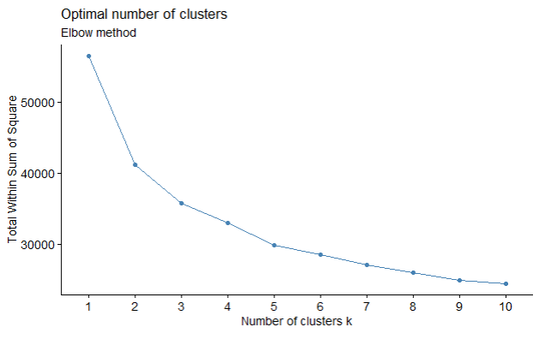
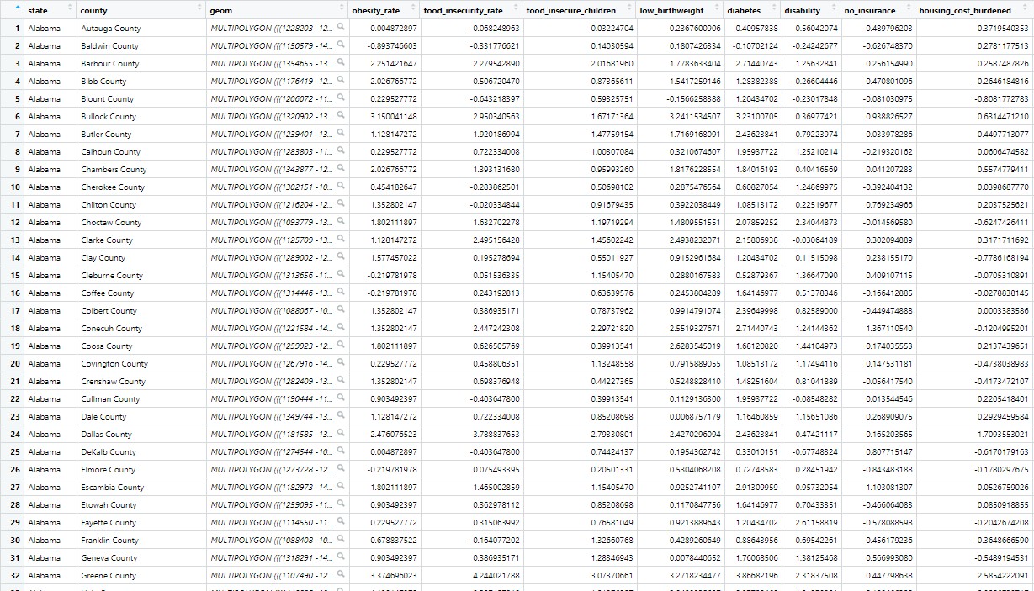
Number of clusters + Scaling
Before starting the analysis, we had to prepare a bit.
By utilizing the elbow method, we determined that the optimal number of clusters for our data would be 5, compared to Urban Institutes’ 10.
Then, we had to scale our data to make the clustering more accurate. We also had to remove a 405/3,135 observations because of NA values.

Slide 22
Cluster Analysis Results
Here are the characterizations for each of our clusters.
Cluster | Counties | Food Insecurity | Obesity | Other Characterizations
1 | 369 | Very high | Very high | The poorest, most people of color, least educated.
2 | 873 | Moderately high | Moderately high | Poor, oldest, most disability, very rural, whiter population.
3 | 305 | Very low | Very low | Very rich, urban, educated, and the youngest
4 | 891 | Low | Moderate | Comfortable economically, less urban, very white.
5 | 475 | Moderate | Moderate | Urban, middle class.

Slide 23
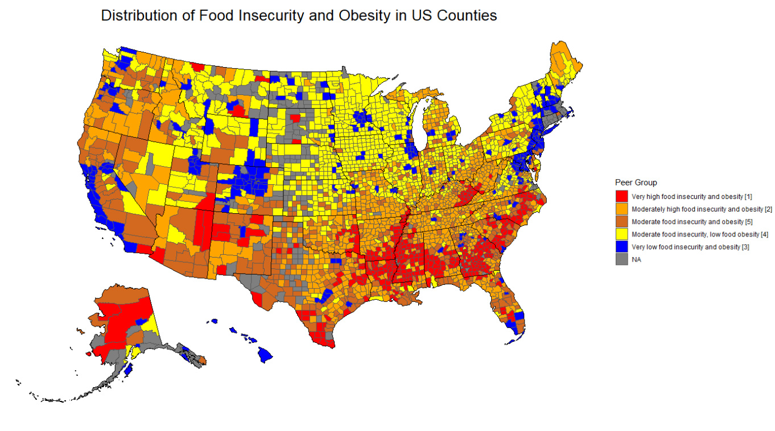

Slide 24
04
Moderation
We wanted to dig deeper into the relationship, and determine if there any moderators in the relationship.

Slide 25
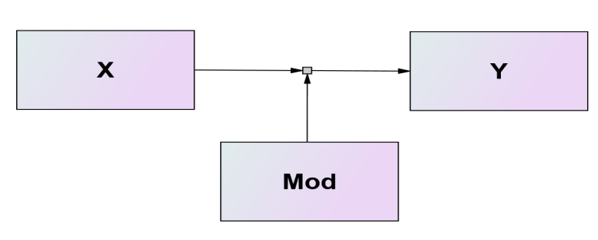
What is a moderation analysis?
Moderation: a statistical technique used to understand how the relationship between two variables changes depending on the level of the third variable, known as the moderator.
So, there are two parts to this.
Main Relationship: the primary relationship that is being studied, usually between an independent variable (food insecurity) and a dependent variable (obesity).
Moderator: This is the third variable that might change the strength or direction of the relationship between the independent variable and the dependent variable.

Slide 26
Our moderators of interest
Based on past research, we decided to choose the following variables as our moderators. Here are some definitions from the urban institute as well, just to understand them a bit better:
People of color: share of people who reported being hispanic or non-hispanic and one of the following races - Black, Asian or Pacific Islander, American Indian or Alaska Native, another race, or multiracial.
Less than college education: share of people ages 25 or older with no college degree (includes associate’s degrees, bachelor’s degrees , and graduate degrees)
Median Income: the middle point of income distribution in a population.
Rural Population: share of a population living in rural areas.
Note: when analyzing the moderation effect, keep in mind that we are looking at the difference between slopes!

Slide 27
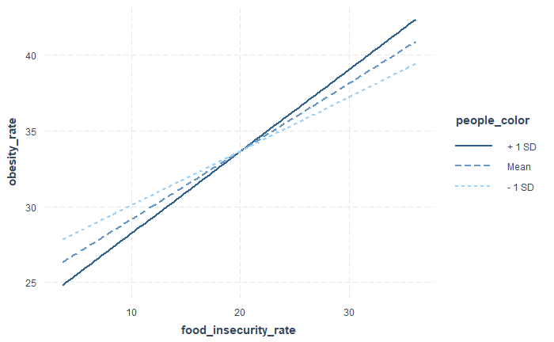
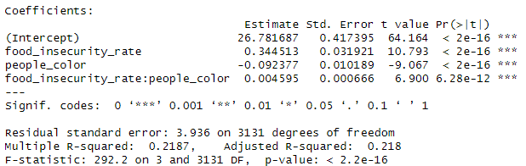
People of Color
The interaction term (0.0046) indicates that the interaction effect increases the impact of food insecurity on obesity as the rates of people of color in a population increases.
It is statistically significant and positive moderator
The r-squared indicates that 21.87% of obesity is explained by this model.
Populations with higher rates of people of color start with the lower obesity rates when there is no food insecurity. But as food insecurity increases, they have a steeper rise in obesity.
Whiter populations start off with a higher obesity rate when there is no food insecurity, but the slope is weaker.
All of the different levels end up crossing at a certain point, which is confusing.
Notes:
People of color has a negative coefficient, which may explain why -1SD intercept is higher than +1SD

Slide 28
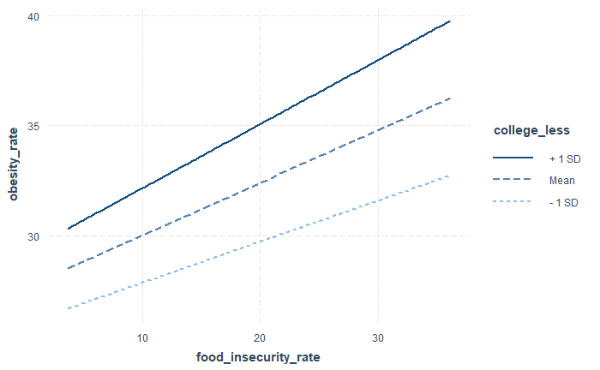
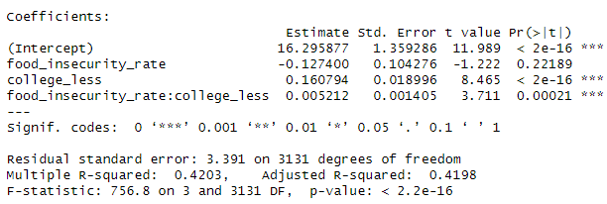
Less than College Education
The interaction term (0.0052) indicates that the interaction effect increases the impact of food insecurity on obesity as less college education increases.
It is statistically significant and positive moderator
The r-squared indicates that 41.98% of obesity is explained by this model.
More educated populations start with lower obesity rates when there is no food insecurity, and have a weaker slope as food insecurity increases.
Less educated populations start with higher obesity rates when there is no food insecurity, and as food insecurity increases, the slope is steeper.

Slide 29
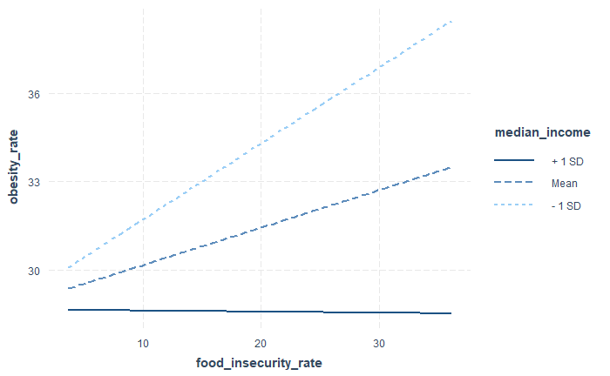
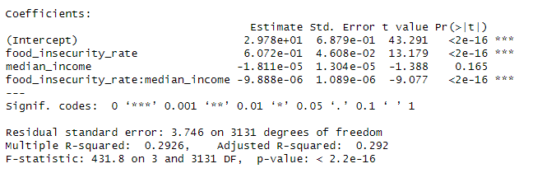
Median Income
The interaction term (-9.888e-06) indicates that the interaction effect decreases the impact of food insecurity on obesity as median income increases.
The interaction term is a statistically significant and negative moderator
The model explains 29.26% of obesity variance
Populations with high income have nearly no interaction between food insecurity and obesity.
As populations get poorer, the relationship between obesity and food insecurity becomes a lot stronger.

Slide 30
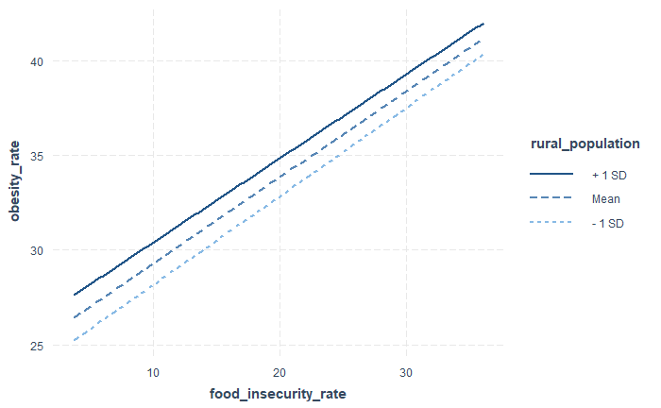
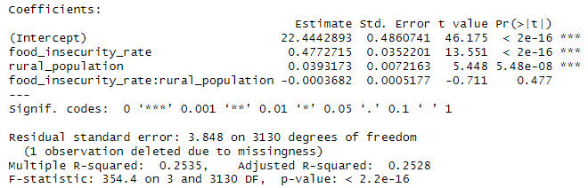
Rural Population
The interaction term indicates that rural population is not a statistically significant moderator.
In other words, changes in rural population levels do not change the interaction between food insecurity and obesity.

Slide 31
05
Conclusion
What are the explanations to these results and takeaways?

Slide 32
Key Takeaways
Our analysis uncovered a statistically significant positive correlation (r = 0.44) between food insecurity and obesity rates, indicating a notable association between these variables.
Through K-means clustering, we identified five distinct county clusters characterized by varying levels of food insecurity and obesity, revealing nuanced patterns within the data.
Moderation analysis revealed the significant roles of race, education level, and median income as moderators in shaping the relationship between food insecurity and obesity, providing deeper insights into the underlying dynamics.
These findings highlight the intricate interplay between socio-economic factors and health outcomes, emphasizing the need for comprehensive approaches to address food insecurity and obesity.

Slide 33
Explanations of the Analyses
Race: Minority populations, particularly Black and Hispanic/Latinx communities, are disproportionately affected by both food insecurity and obesity (Franklin et al., 2011; Drewnowski & Specter, 2004). Structural factors such as systemic racism contribute to limited access to healthy foods and healthcare, exacerbating disparities in health outcomes.
Education: Lower education levels are associated with higher rates of both food insecurity and obesity (Franklin et al., 2011). This can be explained by the limited health literacy and awareness of healthy eating habits among individuals with lower education levels (Burns, 2004).
Income Levels: Economic disparities significantly impact dietary behaviors, with lower-income households facing a heightened risk of food insecurity and obesity (Franklin et al., 2011). Limited financial resources often steer individuals towards cheaper, calorie-dense options, perpetuating unhealthy eating habits and contributing to obesity (Drewnowski & Specter, 2004).
Geographic Location: Rural environments present limited access to nutritious foods and opportunities for physical activity (Trivedi et al., 2015).

